Slide 1
Virtual-Circuit Networks:
Frame Relay and ATM
Frame Relay
ATM
ATM LANs

Slide 2
Introduction
Two common WAN technologies that use virtual-circuit switching are: Frame Relay and ATM.
Frame relay is a relatively high-speed protocol that can provide some services not available in other WAN technologies such as DSL, cable TV, and T lines.
ATM, as a high-speed protocol, is the superhighway of communication such as SONET.

Slide 3
Frame Relay
Frame Relay is a virtual circuit WAN.
Prior to Frame Relay, some organizations were using a virtual-circuit switching network called X.25 that performs switching at network layer.
Disappointed with X.25, some organizations started taking lease T-1 or T-3 lines from public service providers – it also has some drawbanks.
So, Frame Relay was designed.

Slide 4
Frame Relay features:
It operates at a higher speed (1.544 Mbps or 44.376 Mbps). It can easily be used instead of a mesh of T-1 or T-3 lines.
It operates in just the physical and data link layers. So can be used as a backbone network to provide services to protocols that already have a network layer protocol, such as Internet.
It allows bursty data.
It allows a frame size of 9000 bytes accommodating all LAN frame sizes
Less expensive than other traditional WANs.
It has error detection only at the data link layer.

Slide 5
Architecture
Provides permanent virtual circuits (PVC) and switched virtual circuits (SVC).
Fig. shows an example of a Frame Relay network connected to the Internet. Here, Frame Relay WAN is used as one link in the global Internet.
A virtual circuit in Frame Relay is identified by a number called a data link connection identifier (DLCI).

Slide 6
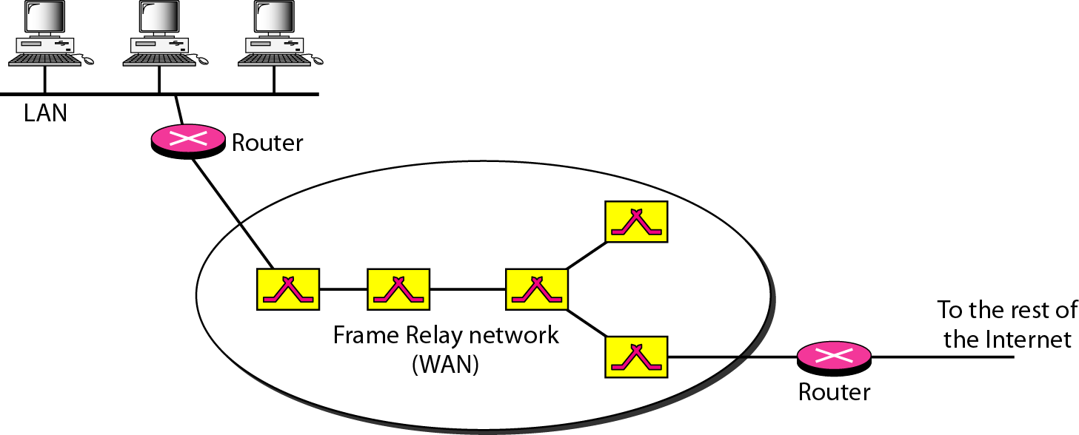
Frame Relay network

Slide 7
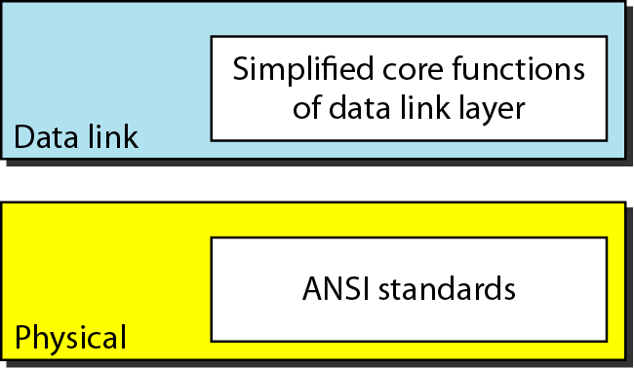
Frame Relay Layers
Frame Relay operates only at the physical and data link layers.
No specific protocol is defined for the physical layer. It supports any of the protocols recognized by ANSI.
Frame Relay layers

Slide 8
At the data link layer, Frame Relay uses a simple protocol that does not support flow or error control.
It only has an error detection mechanism.
Fig. shows the format of a Frame Relay frame.
Descriptions of the address field is as follows:
- DLCI(10bit): first 6 bits of the first byte makes up the first part of the DLCI. Second part of the DLCI used the first 4 bits of the second byte.
- Command/response (C/R) (1bit): it allows the upper layers to identify a frame as either a command or a response. It is not used by the Frame Relay protocol.

Slide 9
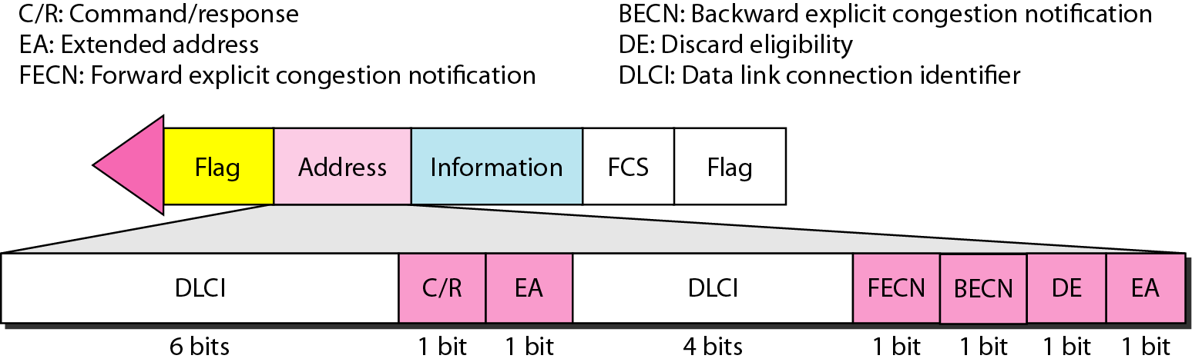
Frame Relay frame

Slide 10
- Extended address(EA) (2bits): it indicates whether the current byte is the final byte of the address. The EA of 0 means that another address byte is to follow. An EA of 1 means that the current byte is the final one.
- Forward explicit congestion notification(FECN) (1bit): this can be set by any switch to indicate that traffic is congested. This informs the destination that congestion has occurred. In this way, the destination knows that it should expect delay or a loss of packets.
- Backward explicit congestion notification(BECN) (1bit): bit is set (in frames that travel in the other direction) to indicate a congestion problem in the

Slide 11
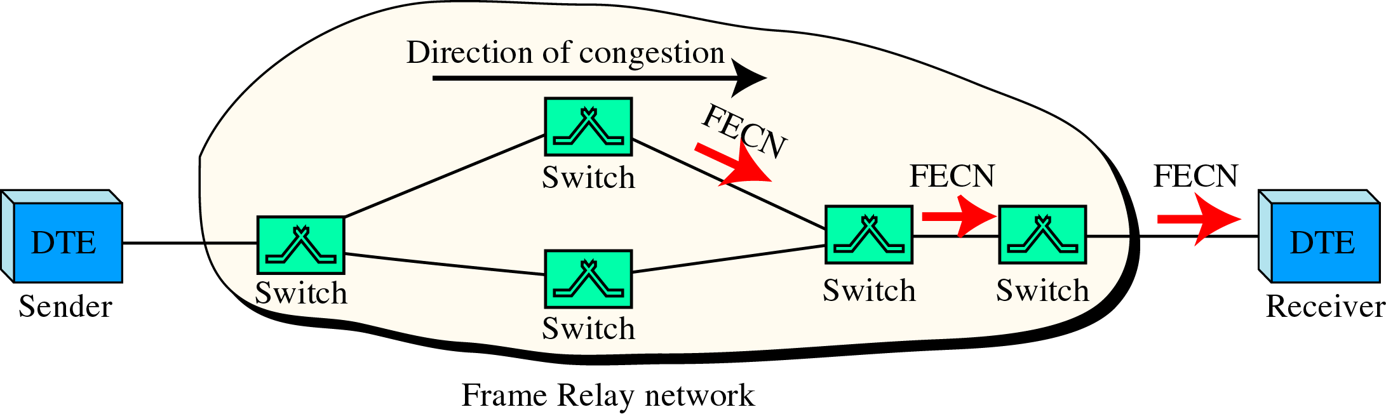
FECN

Slide 12
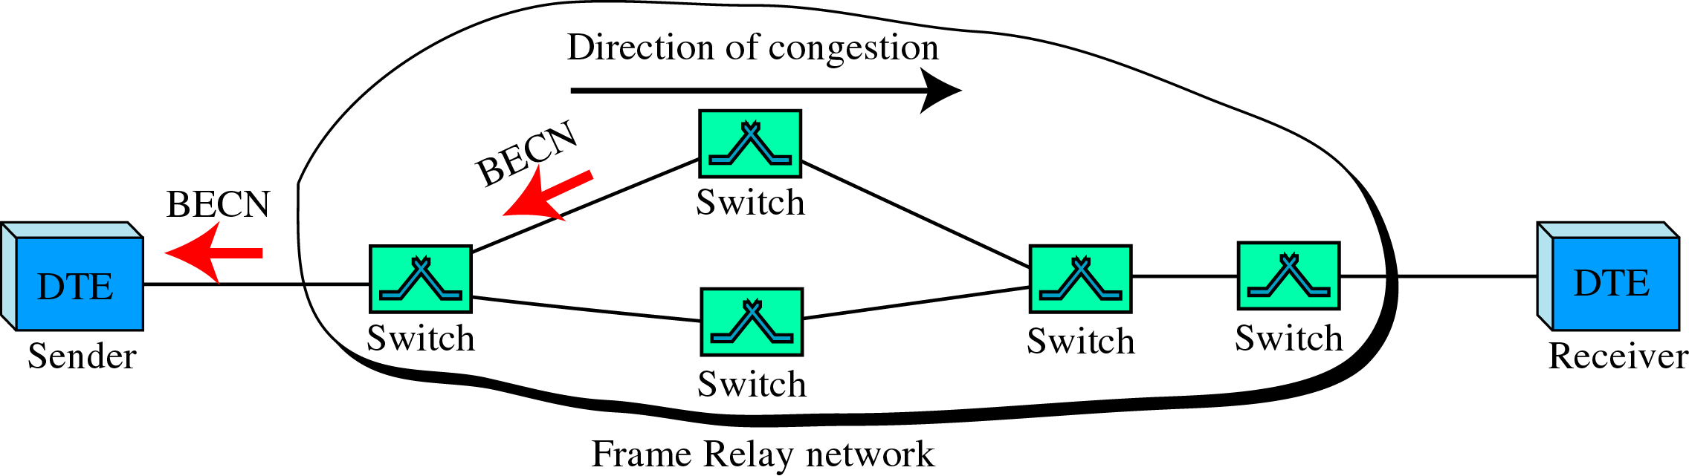
BECN

Slide 13
network. This bit informs the sender that congestion has occurred. In this way, the source knows it needs to slow down to prevent the loss of packets.
- Discard eligibility(DE) (1bit): it indicates the priority level of the frame. When this is set, it tells the network to discard this frame if there is congestion. It can be set either by the sender of the frames or by any switch in the network.

Slide 14
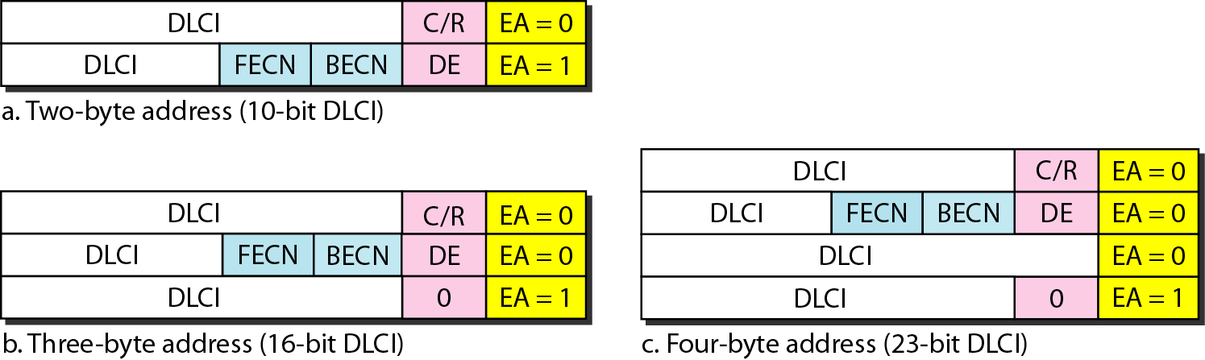
Extended Address
To increase the range of DLCIs, the Frame Relay address has been extended from the original 2-byte address to 3- or 4-byte addresses.
Note that the EA field defines the number of bytes; it is 1 in the last byte of the address, and it is 0 in the other bytes.

Slide 15
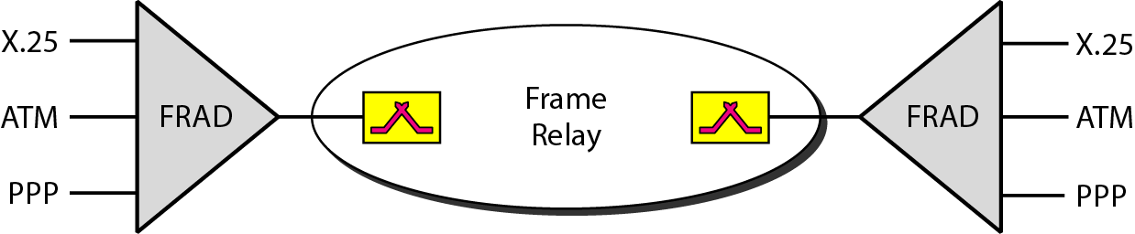
FRADs
To handle frames arriving from other protocols. Frame Relay uses a device called a Frame Relay Assembler/Disassembler (FRAD).
It assembles and disassembles frames coming from other protocols to allow them to be carried by Frame Relay frames.
It can be implemented as a separate device or as part of a switch.

Slide 16
VOFR
Frame Relay networks offer an option called Voice Over Frame Relay (VOFR) that sends voice through the network.
Voice is digitized using PCM and then compressed. The result is sent as data frames over the network.
This feature allows the inexpensive sending of voice over long distances.
However, note that the quality of voice is not as good as voice over a circuit-switched network such as the telephone network.

Slide 17
LMI
Local Management Information (LMI) is a protocol added to the Frame Relay protocol to provide more management features. In particular, LMI can provide
- a keep-alive mechanism to check if data are flowing.
- a multicast mechanism to allow a local end system to send frames to more than one remote end system.
- a mechanism to allow an end system to check the status of a switch.
Congestion Control and Quality of Service
One of the nice features of Frame Relay is that it provides congestion control and quality of service (QoS).

Slide 18
ATM
Full form: Asynchronous Transfer Mode
ATM is the cell relay protocol designed by the ATM forum and adopted by the ITU-T.
ATM uses asynchronous TDM – that is why it is called Asynchronous Transfer Mode.
It can be thought of as the “highway” (data rate: 155 and 622Mbps) of the information superhighway.
Cells are transmitted along virtual circuits.
It has a very developed congestion control and quality of service.

Slide 19
Design Goals
  To provide high data rates, need for a transmission system which offer large bandwidth and less susceptible to noise degradation.
  To provide wide-area interconnectivity, it must interface with existing systems without lowering their effectiveness or requiring their replacement.
  Must be an inexpensive implementation.
  Must support the existing telecommunications hierarchies.
  Must be connection-oriented to ensure accurate and predictable delivery.
  For getting speed, many of the functions are to be hardware implementable.

Slide 20
ATM Architecture
ATM is a cell-switched network.
The user access devices, called the endpoints, are connected through a user-to-network interface (UNI) to the switches inside the network.
The switches are connected through network-to-network interfaces (NNIs).
Virtual connection:
- Connection between two endpoints is accomplished through: Transmission paths (TPs), Virtual paths (VPs), and Virtual circuits (VCs).

Slide 21
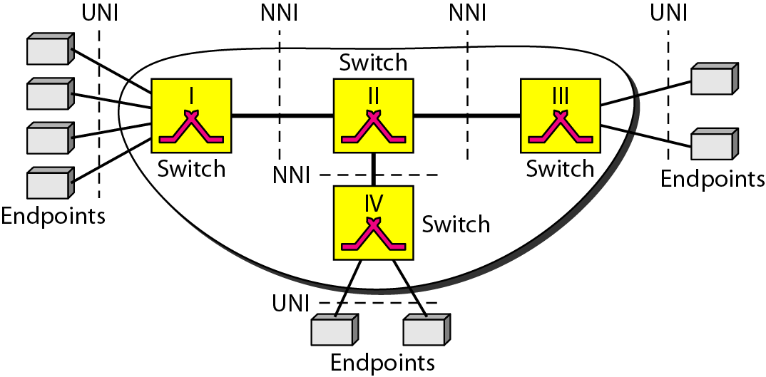
Architecture of an ATM network

Slide 22
- A TP is the physical connection (wire, cable, satellite, and so on) between an endpoint and a switch or between two switches.
- A TP is divided into several VPs.
- A VP provides a connection or a set of connections between two switches.
- Cell networks are based on VCs. All cells belonging to a single message follow the same VC and remain in their original order until they reach their destination.

Slide 23
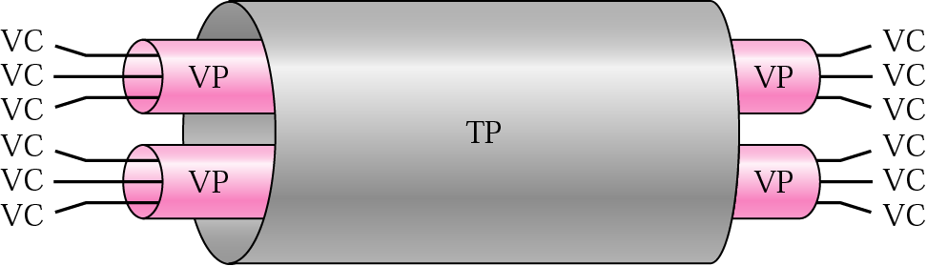
- Fig. shows the relationship between a TP (a physical connection), VPs (a combination of virtual circuits that are bundled together because parts of their paths are the same), and VCs that logically connect two points.
TP, VPs, and VCs

Slide 24
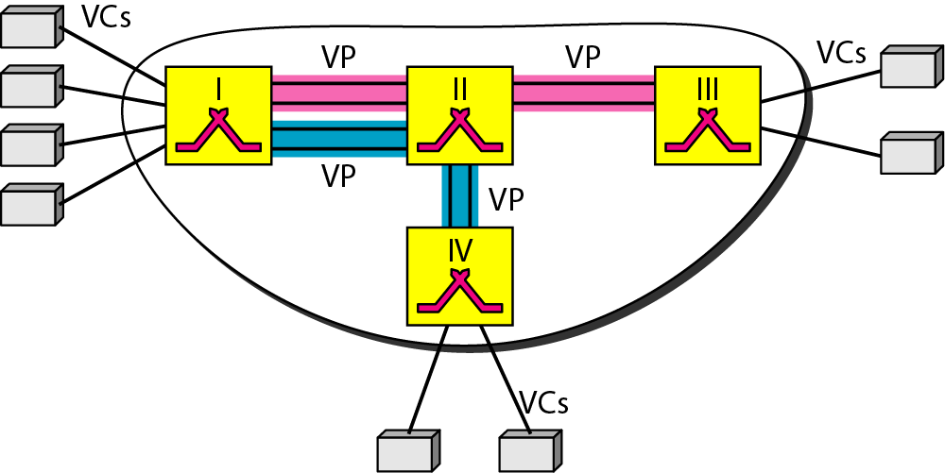
- In the fig., 8 endpoints are communicating using 4 VCs. However, the first 2 VCs seem to share the same VP from switch I to switch III, so it is reasonable to bundle these 2 VCs together to form 1 VP. On the other hand, it is clear that the other 2 VCs share the same path from switch I to switch IV, so it is also reasonable to combine them to form 1 VP.
Example of VPs, and VCs

Slide 25
- In a virtual circuit network, to route data from one endpoint to another, the virtual connections need to be identified. ATM uses a hierarchical identifier with two levels: a virtual path identifier (VPI) and a virtual circuit identifier (VCI).
- VPI defines the specific VP, and the VCI defines a particular VC inside the VP.
- The VPI is the same for all virtual connections that are bundled (logically) into one VP.
- Note that a virtual connection is defined by a pair of numbers: the VPI and the VCI.

Slide 26
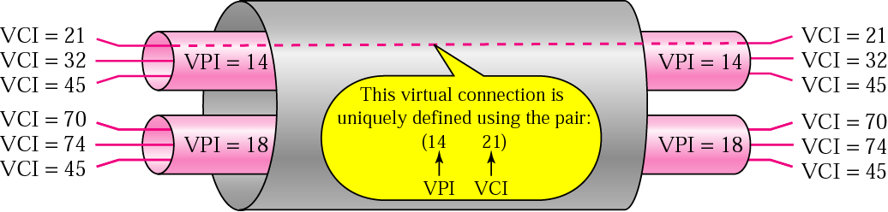
- Fig. shows the VPIs and VCIs for a transmission path.
Connection identifiers

Slide 27
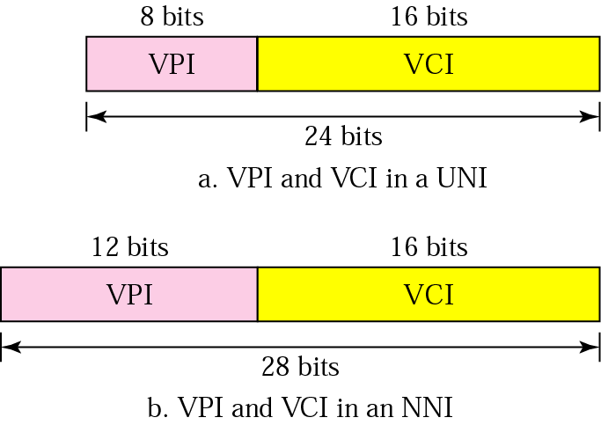
- The lengths of the VPIs for UNIs and NNIs are different. In a UNI, the VPI is 8 bits, whereas in an NNI, the VPI is 12 bits. The length of the VCI is the same in both interfaces (16 bits).
- Therefore, a VC is identified by 24 bits in a UNI and by 28 bits in an NNI.
Virtual connection identifiers in UNIs and NNIs

Slide 28
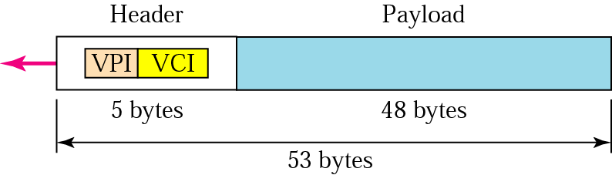
Cells
- The basic data unit in an ATM network is called a cell.
- A cell is only 53 bytes long with 5 bytes allocated to the header and 48 bytes carrying the payload (user data may be less than 48 bytes)
- Most of the header is occupied by the VPI and VCI that define the virtual connection through which a cell should travel from an endpoint to a switch or from a switch to another switch.
An ATM cell

Slide 29
Connection Establishment and Release
- Like Frame Relay, ATM uses two types of connections: PVC and SVC.
PVC: A permanent virtual-circuit connection is established between two endpoints by the network provider. The VPIs and VCIs are defined for the permanent connections, and the values are entered for the tables of each switch.
SVC: In a switched virtual-circuit connection, each time an endpoint wants to make a connection with another endpoint, a new virtual circuit must be established. ATM cannot do the job by itself. The actual mechanism depends on the network layer protocol.

Slide 30
Switching
ATM uses switches to route the cell from a source endpoint to the destination endpoint.
A switch routes the cell using both the VPIs and the VCIs.
The routing requires the whole identifier.
The fig. shows how a VPC switch routes the cell.
- a cell with a VPI of 153 and VCI of 67 arrives at switch interface (port) 1. The switch checks its switching table, which stores six pieces of information per row: arrival interface number, incoming VPI, incoming VCI, corresponding

Slide 31
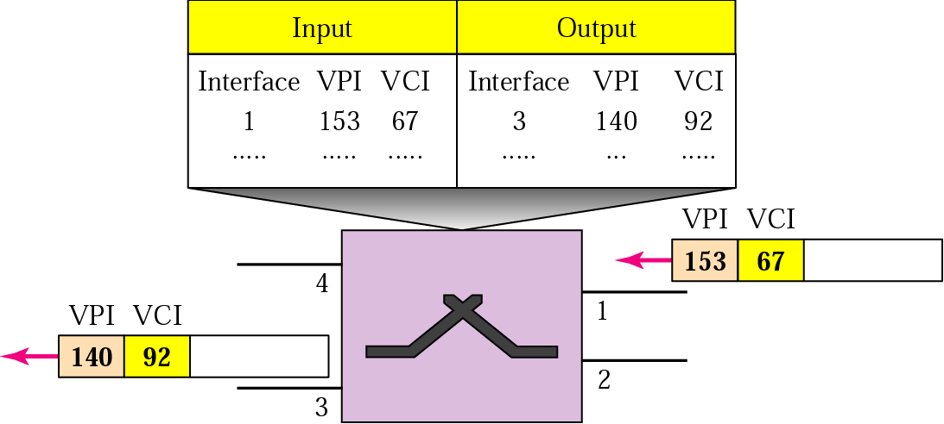
Routing with a Switch

Slide 32
outgoing interface number, the new VPI, and the new VCI. The switch finds the entry with the interface 1, VPI 153, and VCI 67 and discovers that the combination corresponds to output interface 3, VPI 140, and VCI 92. It changes the VPI and VCI in the header to 140 and 92, respectively, and sends the cell out through interface 3.

Slide 33
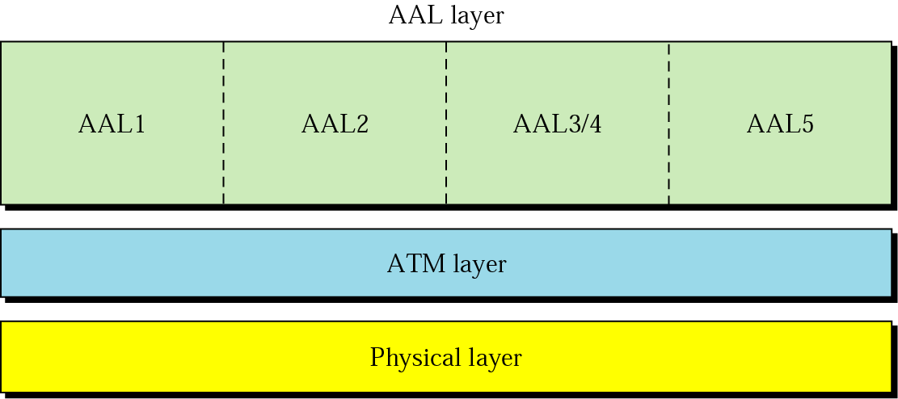
ATM Layers
The ATM standard defines the three layers.
They are, from top to bottom, the application adaptation layer, the ATM layer, and the physical layer.

Slide 34
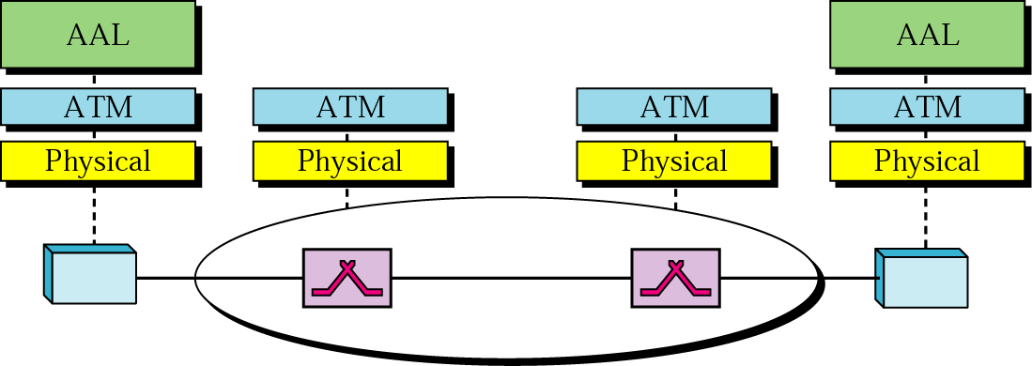
The endpoints use all three layers while the switches use only the two bottom layers.

Slide 35
Physical Layer:
- Like Ethernet and wireless LANs, ATM cells can be carried by any physical layer carrier.
- the original design of ATM was based on SONET as the physical layer carrier.
- ATM does not limit the physical layer to SONET. Other technologies, even wireless, may be used.

Slide 36
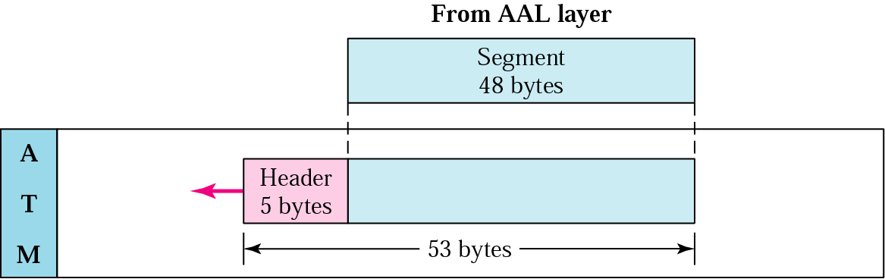
ATM Layer:
- The ATM layer provides routing, traffic management, switching, and multiplexing services.
- it processes outgoing traffic by accepting 48-byte segments from the AAL sublayers and transforming them into 53-byte cells by the addition of a 5-byte header.

Slide 37
Header Format
- ATM uses two formats for this header, one for UNI cells and another for NNI cells.
- GFC: this 4-bit field provides flow control at the UNI level. This level of flow control is not necessary at the NNI level. In the NNI header, therefore, these bits are added to the VPI.
- VPI: 8-bit field in a UNI cell and 12-bit field in an NNI cell.
- VCI: 16-bit field in both frames.

Slide 38
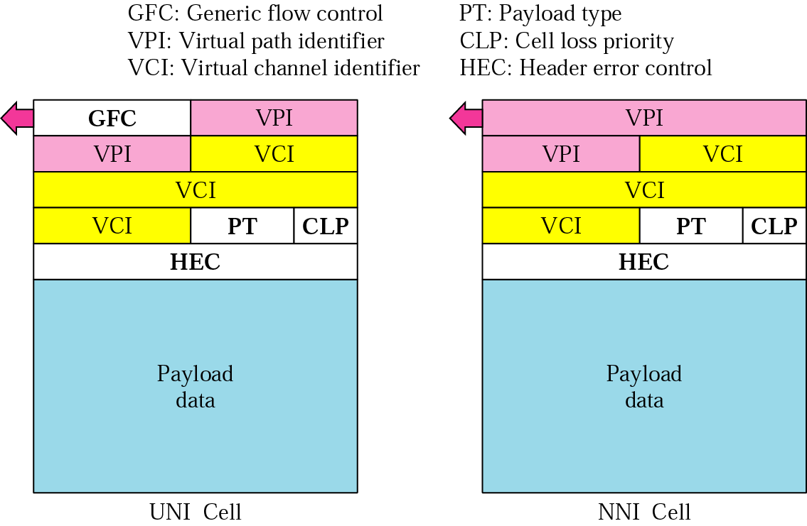
ATM headers

Slide 39
- PT: in the 3-bit field, the first bit defines the payload as user data or managerial information.
- CLP: this 1-bit field is for congestion control. A cell with its CLP bit set to 1 must be retained as long as there are cells with a CLP of 0.
- HEC: The HEC is a code computed for the first 4 bytes of the header. It is a CRC with the divisor x⁸ + x² + x + 1 that is used to correct single-bit errors and a large class of multiple-bit errors.

Slide 40
Application Adaptation Layer (AAL):
- The AAL was designed to enable two ATM concepts;
1. ATM must accept any type of payload, both data frames and streams of bits.
2. ATM must carry multimedia payload.
- AAL uses two sublayers to accomplish these tasks.
- Whether the data are a data frame or a stream of bits, the payload must be segmented into 48-byte segments to be carried by a cell. At the destination, these segments need to be reassmebled to recreate the original payload.

Slide 41
The sublayer, segmentation and reassembly (SAR) does this work. Segmentation is at the source; reassembly, at the destination.
- Before data are segmented by SAR, they must be prepared to guarantee the integrity of the data. This is done by the sublayer, called the convergence sublayer (CS).
- ATM defines four versions of the AAL: AAL1, AAL2, AAL3/4, and AAL5.
- Common versions of today are AAL1 and AAL5. The first is used in streaming audio and video communication; the second, in data communications.

Slide 42
AAL1:
Supports applications that transfer information at constant bit rates, such as video and voice.
It allows ATM to connect existing digital telephone networks such as voice channels and T lines.
The CS sublayer divides the bit stream into 47-byte segments and passes them to the SAR sublayer below. Note that the CS sublayer does not add a header.
The SAR sublayer adds 1 byte of header and passes the 48-byte segment to the ATM layer.

Slide 43
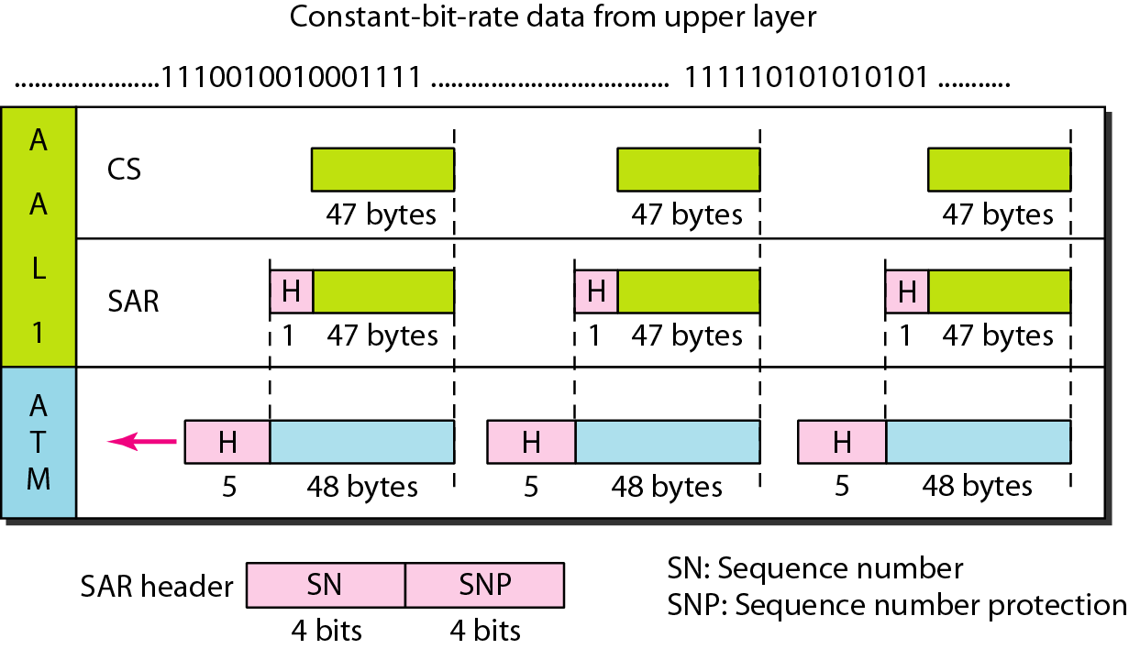
AAL1

Slide 44
The header has two fields:
- SN: 4-bit field defines a sequence number to order the bits. The first bit is sometimes used for timing, which leaves 3 bits for sequencing (modulo 8).
- SNP: the second 4-bit field protects the first field. The first 3 bits automatically correct the SN field. The last bit is a parity bit that detects error over all 8 bits.

Slide 45
AAL2:
It is used for low-bit-rate traffic and short-frame traffic such as audio (compressed or uncompressed), video, or fax.
An example of AAL2 use is in mobile telephony.
AAL2 allows the multiplexing of short frames into one cell.
Fig. shows the process of encapsulating a short frame from the same source (the same user of a mobile phone) or from several sources (several users of mobile telephones) into one cell.

Slide 46
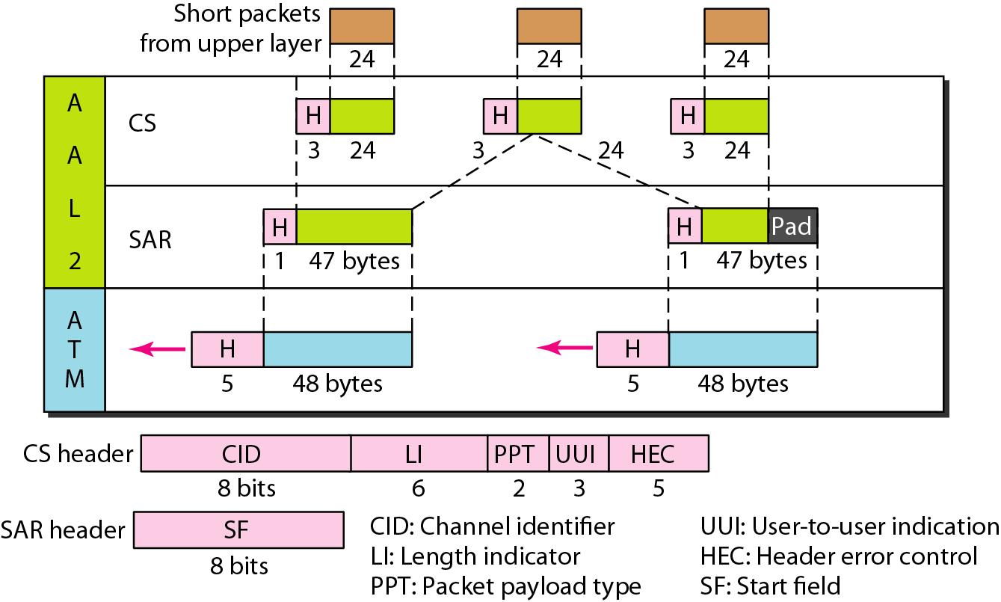
AAL2
18-<number>

Slide 47
The CS layer overhead consists of 5 fields:
- CID: 8-bit field defines the channel (user) of the short packet.
- LI: 6-bit field indicates how much of the final packet is data.
- PPT: defines the type of packet.
- UUI: can be used by end-to-end users.
- HEC: last 5 bits is used to correct errors in the header.
The only overhead at the SAR layer is the SF, defines the offset from the beginning of the packet.

Slide 48
AAL3/4:
Support connection-oriented and connectionless data services.
The CS layer header and trailer consist of 6 fields:
- CPI: defines how the subsequent fields are to be interpreted. The value at present is 0.
- Btag: the value of this field is repeated in each cell to identify all the cells belonging to the same packet. The value is the same as the Etag.
- BAsize: 2-byte field tells the receiver what size buffer is needed for the coming data.
- AL: 1-byte field is included to make the rest of the trailer 4 bytes long.

Slide 49
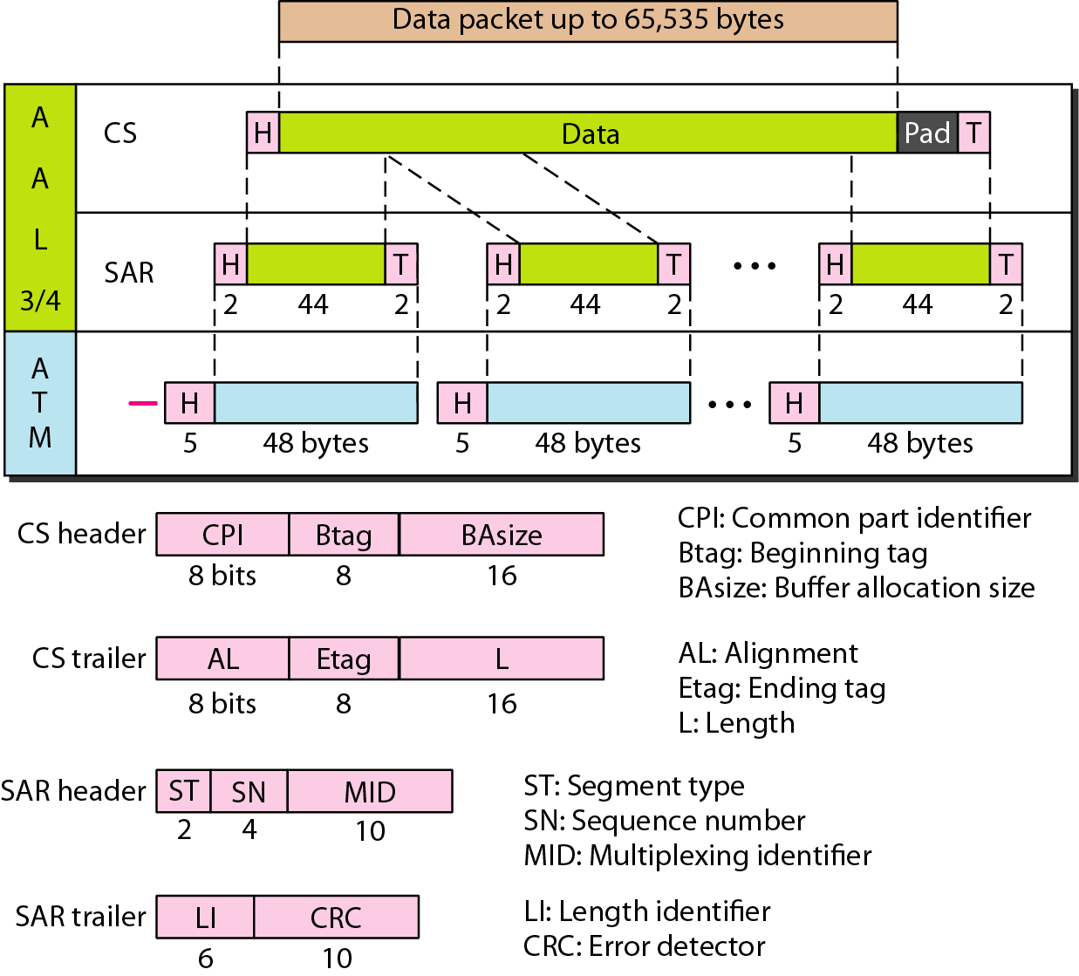
AAL3/4
18-<number>

Slide 50
- Etag: 1-byte field serves as an ending flag. Its value is the same as that of the beginning tag.
- L: 2-byte field indicates the length of the data unit.
The SAR header and trailer consist of 5 fields:
- ST: 2-bit identifier specifies the position of the segment in the message: beginning (00), middle (01), or end (10). A single-segment message has an ST of 11.
- SN: same as defined previously.
- MID: 10-bit field identifies cells coming from different data flows and multiplexed on the same virtual connection.

Slide 51
- LI: defines how much of the packet is data, not padding.
- CRC: last 10 bits of the trailer is a CRC for the entire data unit.

Slide 52
AAL5:
Provides comprehensive sequencing and error control mechanisms that are not necessary for every application.
It is called the SEAL (Simple and Efficient Adaptation Layer).
It assumes that all cells belonging to a single message travel sequentially and that control functions are included in the upper layers of the sending application.

Slide 53
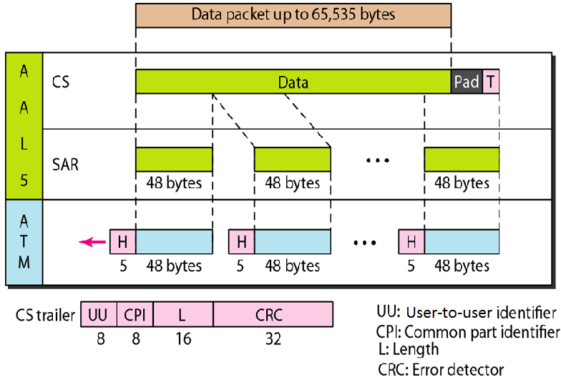
AAL5

Slide 54
The 4 trailer fields in the CS layer are:
- UU: same as described previously.
- CPI: same as defined previously.
- L: 2-byte field indicates the length of the original data.
- CRC: last 4-bytes is error control on the entire data unit.

Slide 55
ATM LANs
ATM is mainly a wide-area network (WAN ATM); however, the technology can be adapted to local-area networks (ATM LANs).
ATM technology has several advantages that make it an ideal LAN:
- supports permanent and temporary connections.
- supports multimedia communication with a variety of bandwidths for different applications.
- an ATM LAN can be easily adapted for expansion in an organization.

Slide 56
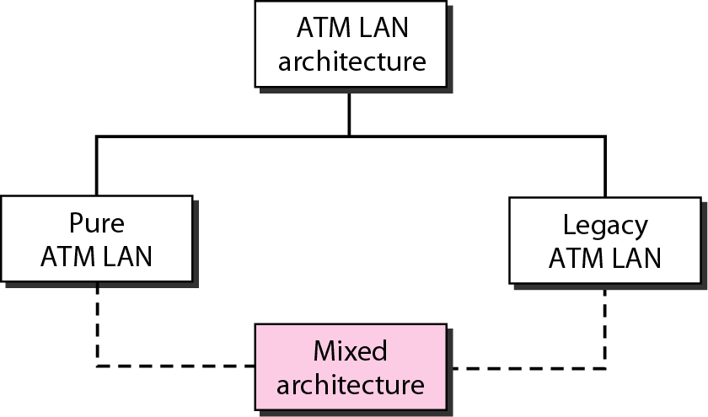
ATM LAN Architecture
Two ways to incorporate ATM technology in a LAN architecture: creating a pure ATM LAN or making a legacy ATM LAN.

Slide 57
Pure ATM Architecture
- Here, an ATM switch is used to connect the stations in a LAN, in exactly the same way stations are connected to an Ethernet switch.
- stations can exchange data at one of the two standard rates of ATM technology. However, the station uses a virtual path identifier (VPI) and a virtual circuit identifier (VCI), instead of a source and destination address.
- Drawback: the system needs to be built from the ground up; existing LANs cannot be upgraded into pure ATM LANs.

Slide 58
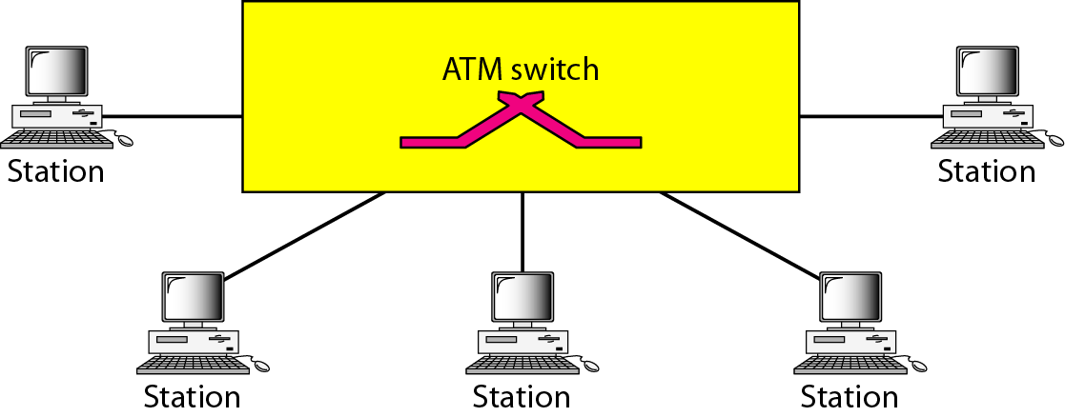
Pure ATM LAN

Slide 59
Legacy ATM Architecture
- Here, ATM technology used as a backbone to connect traditional LANs.
- stations on the same LAN can exchange data at the rate and format of traditional LANs (Ethernet, Token Ring, etc.).
- but, when two stations on two different LANs need to exchange data, they can go through a converting device that changes the frame format.
- Advantage: output from several stations can be multiplexed together to create a high-data-rate input to the ATM switch.

Slide 60
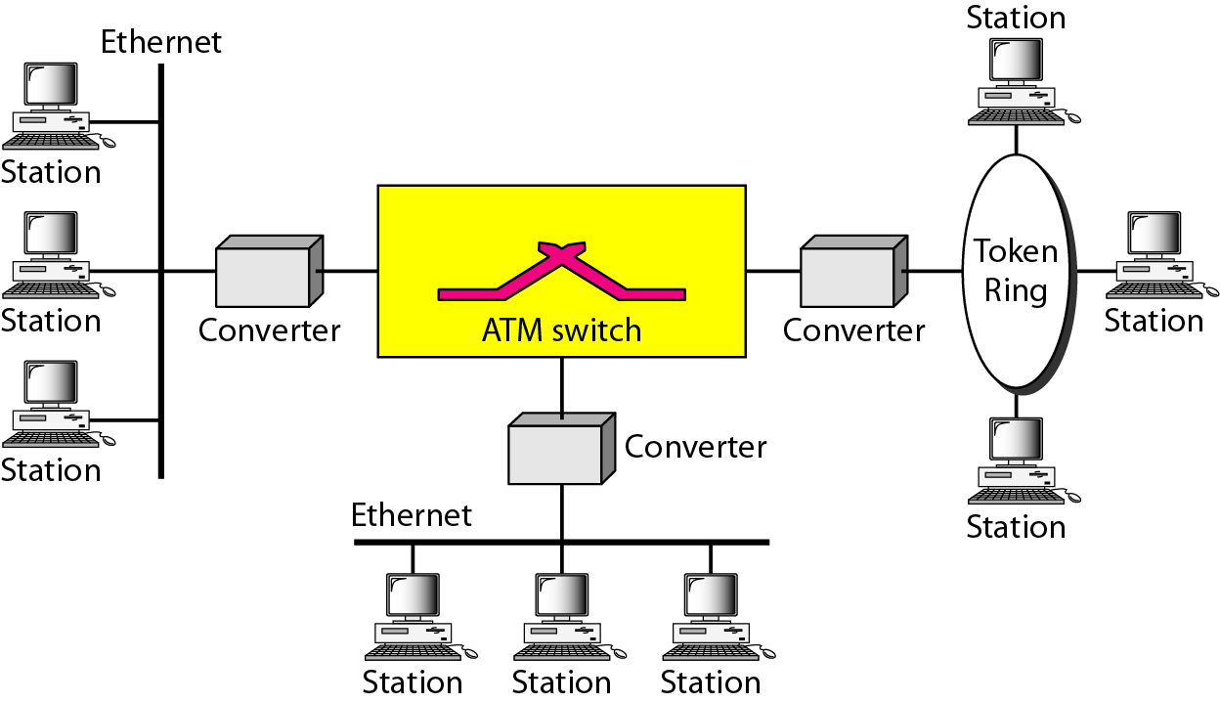
Legacy ATM LAN

Slide 61
Mixed Architecture
- means keeping the existing LANs and, at the same time, allowing new stations to be directly connected to an ATM switch.
- it allows the gradual migration of legacy LANs onto ATM LANs by adding more and more directly connected stations to the switch.
- the stations in one specific LAN can exchange data using the format and data rate of that particular LAN.
- the stations directly connected to the ATM switch can use an ATM frame to exchange data.

Slide 62
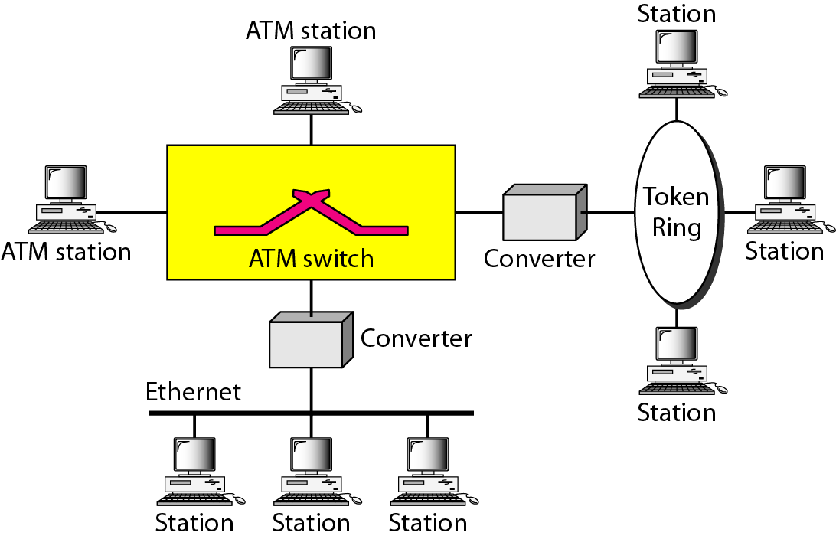
Mixed Architecture ATM LAN

Slide 63
- how can a station in a traditional LAN communicate with a station directly connected to the ATM switch or vice versa? This problem is resolved using LANE.

Slide 64
At the surface level, the use of ATM technology in LANs seems like a good idea. However, many issues need to be resolved.
  Connectionless versus connection-oriented: Traditional LANs, such as Ethernet, are connectionless protocols. On the other hand, ATM is a connection-oriented protocol.
  Physical addresses versus virtual-circuit identifiers: a connectionless protocol, such as Ethernet, defines the route of a packet through source and destination addresses. However, a connection-oriented protocol, such as ATM, defines the route of a cell through virtual connection identifiers. (VPIs and VCIs).

Slide 65
  Multicasting and broadcasting delivery: traditional LANs, such as Ethernet, can both multicast and broadcast packets. There is no easy way to multicast or broadcast on an ATM network although point-to-multipoint connections are available.
  Interoperability: in a mixed architecture, a station connected to a legacy LAN must be able to communicate with a station directly connected to an ATM switch.

Slide 66
LAN Emulation (LANE)
An approach, local-area network emulation solves the above-mentioned problems and allows stations in a mixed architecture to communicate with one another.
Stations can use connectionless service that emulates a connection-oriented service.
Stations use the source and destination addresses for initial connection and then use VPI and VCI addressing.
The approach allows stations to use unicast, multicast, and broadcast addresses.
Finally, the approach converts frames using a legacy format to ATM cells before they are sent through the switch.

Slide 67
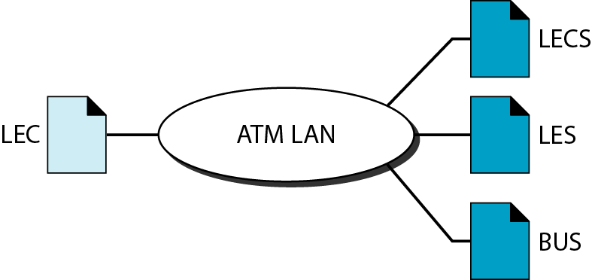
Client/Server Model
  LANE is designed as a client/server model to handle the four previously discussed problems.
  The protocol uses one type of client and three types of servers, as shown in fig: LANE Configuration Server (LECS), LANE Server (LES), Broadcast/Unknown Server (BUS), and LANE Client (LEC).
18-<number>

Slide 68
LEC
  All ATM stations have LEC software installed on top of the three ATM protocols.
  Upper-layer protocols are unaware of the existence of the ATM technology. These protocols send their requests to LEC for a LAN service such as connectionless delivery using MAC unicast, multicast, or broadcast addresses. The LEC, however, just interprets the request and passes the result on to the servers.

Slide 69
LECS
  The LECS is used for the initial connection between the client and LANE.
  This server is always waiting to receive the initial contact.
  It has a well-known ATM address that is known to every client in the system.
LES
  LES software is installed on the LES.
  When a station receives a frame to be sent to another station using a physical address, LEC sends a special frame to the LES.

Slide 70
  The server creates a virtual circuit between the source and the destination station.
  The source station can now use this virtual circuit (and the corresponding identifier) to send the frame or frames to the destination.
BUS
  Multicasting and broadcasting require the use of another server called the BUS.
  If a station needs to send a frame to a group of stations or to every station, the frame first goes to the BUS; this server has permanent virtual connection to every station.

Slide 71
  The server creates copies of the received frame and sends a copy to a group of stations or to all stations, simulating a multicasting or broadcasting process.
  The server can also deliver a unicast frame by sending the frame to every station. In this case the destination address is unknown. This is sometimes more efficient than getting the connection identifier from the LES.

Slide 72
Mixed Architecture with Client/Server
  Fig. shows clients and servers in a mixed architecture ATM LAN.
  In the figure, three types of servers are connected to the ATM switch (they can actually be part of the switch). Also two types of clients are shown.
  Stations A and B, designed to send and receive LANE communication, are directly connected to the ATM switch.
  Stations C, D, E, F, G, and H in traditional legacy LANs are connected to the switch via a converter.
  These converters act as LEC clients and communicate on behalf of their connected stations.

Slide 73
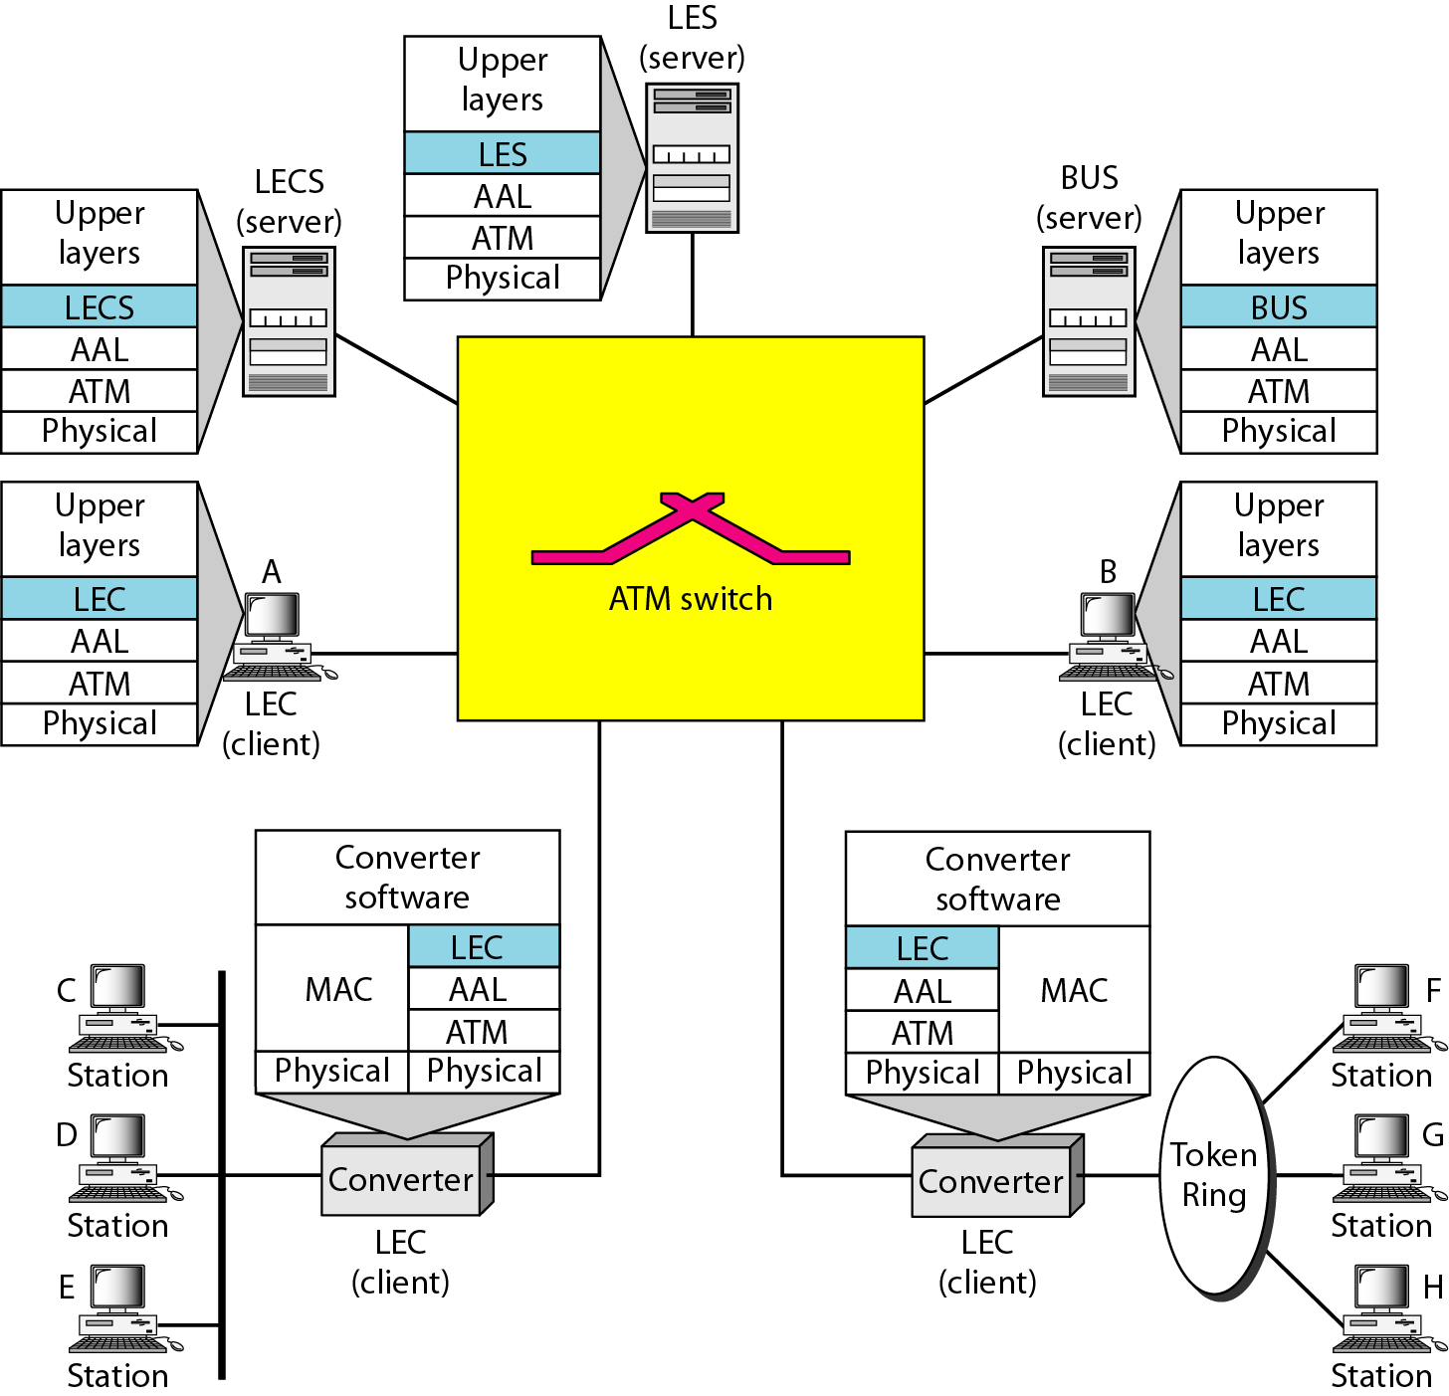
A Mixed Architecture ATM LAN Using LANE
18-<number>

